Slide 1

High Boost filtering
In image processing, it is often desirable to emphasize high frequency components representing the image details without eliminating low frequency components (such as sharpening). The high-boost filter can be used to enhance high frequency component.
Course Name: Digital Image Processing Level(UG/PG): UG
Author(s) : Phani Swathi Chitta
Mentor: Prof. Saravanan Vijayakumaran
*The contents in this ppt are licensed under Creative Commons Attribution-NonCommercial-ShareAlike 2.5 India license

Slide 2
Learning Objectives
After interacting with this Learning Object, the learner will be able to:
Explain the method of sharpening using High Boost Filtering

Slide 3
Definitions of the components/Keywords:
1
The high-boost filter can be used to enhance high frequency component
while still keeping the low frequency components.
High boost filter is composed by an all pass filter and a edge detection filter
(laplacian filter). Thus, it emphasizes edges and results in image sharpener.
The high-boost filter is a simple sharpening operator in signal and image
processing.
It is used for amplifying high frequency components of signals
and images. The amplification is achieved via a procedure which subtracts a
smoothed version of the media data from the original one.
In image processing, we can sharpen edges of a image through the
amplification and obtain a more clear image.
The high boost filtering is expressed in equation form as follows:
Where is the high boost convolution kernel and A is a constant
2
3
4
5

Slide 4
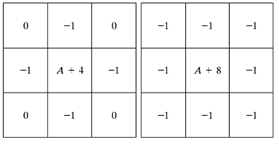
Definitions of the components/Keywords:
1
Unsharp masking filter (High-boost filter) removes the blurred parts and enhances the edges
The high-boost filtering technique can be implemented using the masks given below for
2
3
4
5

Slide 5
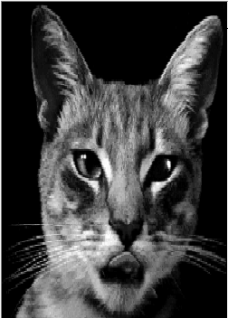
Master Layout
1
Original Image
Image after sharpening
2
3
Give radio buttons to select the mask and the masks are given below
Give a slider to select any one value of sigma ranging from 1 to 2
4
5

Slide 6
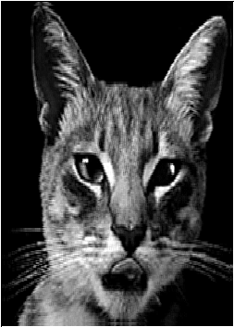
Step 1:
Mask 1,Sigma =1
1
2
3
4
Instruction for the animator | Text to be displayed in the working area (DT)
The first fig. should appear and then when the slider points at sigma, the second fig. should be shown The text in DT should appear in parallel to the figures | The original image The resulting image after high boost filtering is applied The filter mask used for filtering is mask 1 and sigma=1
5

Slide 7
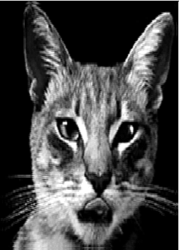
Step 2:
mask 1, Sigma 1.2
1
2
3
4
Instruction for the animator | Text to be displayed in the working area (DT)
The first fig. should appear and then when the slider points at sigma, the second fig. should be shown The text in DT should appear in parallel to the figures | The original image The resulting image after high boost filtering is applied The filter mask used for filtering is mask 1 and sigma=1.2
5

Slide 8
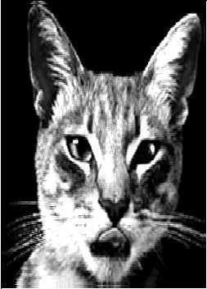
Step 3:
Mask 1, Sigma 1.5
1
2
3
4
Instruction for the animator | Text to be displayed in the working area (DT)
The first fig. should appear and then when the slider points at sigma, the second fig. should be shown The text in DT should appear in parallel to the figures | The original image The resulting image after high boost filtering is applied The filter mask used for filtering is mask 1 and sigma=1.5
5

Slide 9
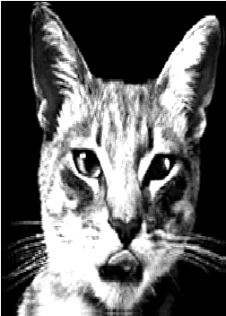
Step 4:
Mask 1, Sigma 1.8
1
2
3
4
Instruction for the animator | Text to be displayed in the working area (DT)
The first fig. should appear and then when the slider points at sigma, the second fig. should be shown The text in DT should appear in parallel to the figures | The original image The resulting image after high boost filtering is applied The filter mask used for filtering is mask 1 and sigma=1.8
5

Slide 10
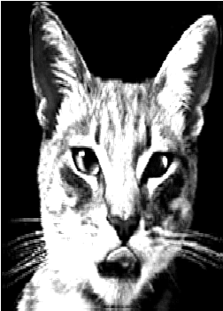
Step 5:
Mask 1, Sigma 2
1
2
3
4
Instruction for the animator | Text to be displayed in the working area (DT)
The first fig. should appear and then when the slider points at sigma, the second fig. should be shown The text in DT should appear in parallel to the figures | The original image The resulting image after high boost filtering is applied The filter mask used for filtering is mask 1 and sigma=2
5

Slide 11
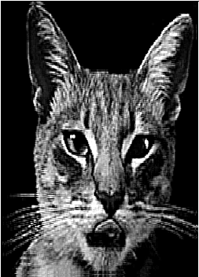
Step 6:
Mask 2, Sigma 1
1
2
3
4
Instruction for the animator | Text to be displayed in the working area (DT)
The first fig. should appear and then when the slider points at sigma, the second fig. should be shown The text in DT should appear in parallel to the figures | The original image The resulting image after high boost filtering is applied The filter mask used for filtering is mask 2 and sigma=1
5

Slide 12
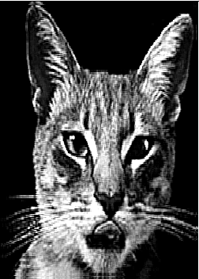
Step 7:
Mask 2,Sigma 1.2
1
2
3
4
Instruction for the animator | Text to be displayed in the working area (DT)
The first fig. should appear and then when the slider points at sigma, the second fig. should be shown The text in DT should appear in parallel to the figures | The original image The resulting image after high boost filtering is applied The filter mask used for filtering is mask 2 and sigma=1.2
5

Slide 13

Step 8:
Mask 2, Sigma 1.5
1
2
3
4
Instruction for the animator | Text to be displayed in the working area (DT)
The first fig. should appear and then when the slider points at sigma, the second fig. should be shown The text in DT should appear in parallel to the figures | The original image The resulting image after high boost filtering is applied The filter mask used for filtering is mask 2 and sigma=1.5
5

Slide 14
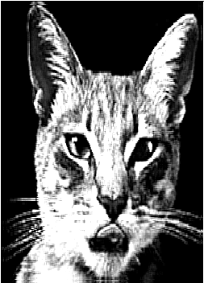
Step 9:
Mask 2, Sigma 1.8
1
2
3
4
Instruction for the animator | Text to be displayed in the working area (DT)
The first fig. should appear and then when the slider points at sigma, the second fig. should be shown The text in DT should appear in parallel to the figures | The original image The resulting image after high boost filtering is applied The filter mask used for filtering is mask 2 and sigma=1.8
5

Slide 15
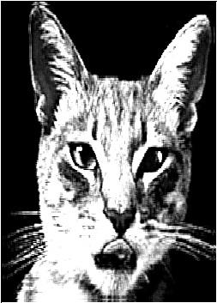
Step 10:
Mask 2, Sigma 2
1
2
3
4
Instruction for the animator | Text to be displayed in the working area (DT)
The first fig. should appear and then when the slider points at sigma, the second fig. should be shown The text in DT should appear in parallel to the figures | The original image The resulting image after high boost filtering is applied The filter mask used for filtering is mask 2 and sigma=2
5

Slide 16
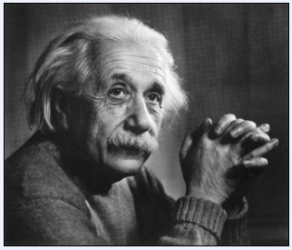
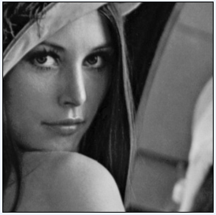
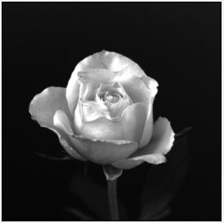
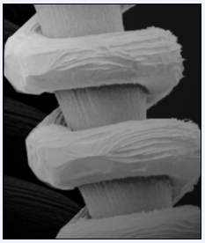
Electrical Engineering
Slide 1
Slide 3
Slide
23, 24,25
Slide 26
Introduction
Definitions
Analogy
Test your understanding
(questionnaire)‏
Lets Sum up (summary)‏
Want to know more…
(Further Reading)‏
Interactivity:
Try it yourself
Select any one of the figures
a b
c d
Select the value of sigma
Credits

Slide 17
Questionnaire
1
If A is very large, the high boost filtered image contains large number of white pixels. Why?
Hint: Pixel values >255 show up as white
Answers:
a) when A is large, high boost filtering results in a lot of pixels with values >255
b) When A is large, the high pass component of the image is large resulting in a lot of white pixels
c) When A is large, the low pass component of the image is large resulting in a lot of white pixels
d) All the above
2
3
4
5

Slide 18
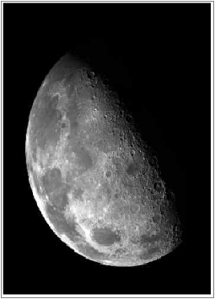
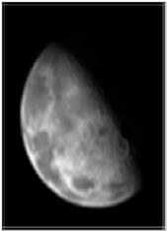
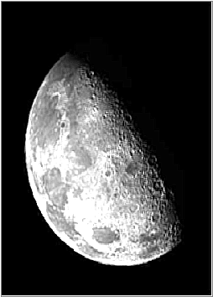
Questionnaire
1
2. Which is the resulting image if high boost filter is applied to the original image?
Answers: a) b)
2
3
Original Image
4
5

Slide 19
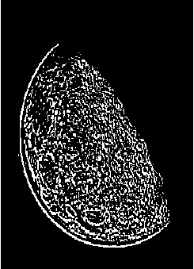
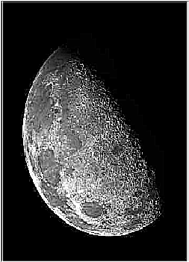
Questionnaire
1
2. Which is the resulting image if high boost filter is applied to the original image?
Answers: c) d)
2
3
Original Image
4
5

Slide 20
Links for further reading
Reference websites:
http://www.cvip.uofl.edu/wwwcvip/education/ECE618_2004/download/project2.pdf
http://homepages.inf.ed.ac.uk/rbf/CVonline/LOCAL_COPIES/OWENS/LECT5/node3.html
http://fourier.eng.hmc.edu/e161/lectures/gradient/node2.html
http://en.wikipedia.org/wiki/Unsharp_masking
Books:
Digital Image Processing – Rafael C. Gonzalez, Richard E. Woods, Third edition, Prentice Hall

